Slide 1
1) PLM Demo: Change Order

Slide 2
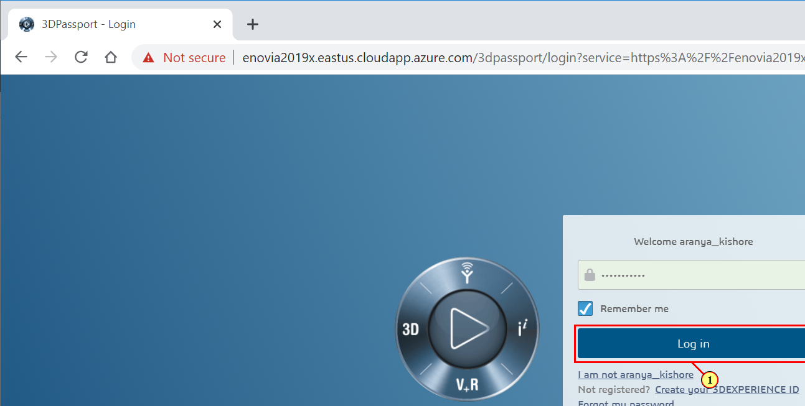
3DPassport - Login - Google Chrome
(1) Enter your Username and Password to Log In.

Slide 3
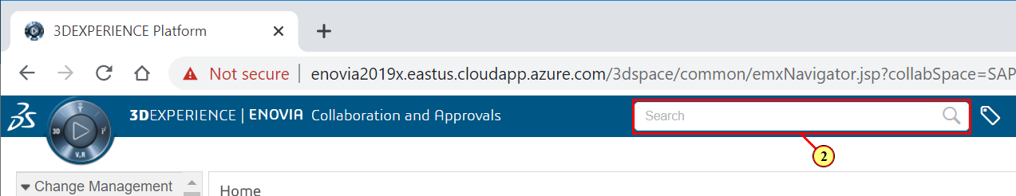
3DEXPERIENCE Platform - Google Chrome
(2) Click Search to find an object.

Slide 4
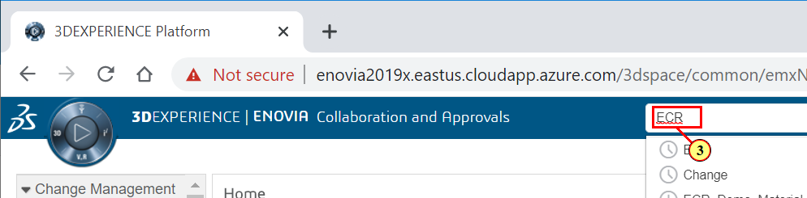
3DEXPERIENCE Platform - Google Chrome
(3) Search for an item.

Slide 5
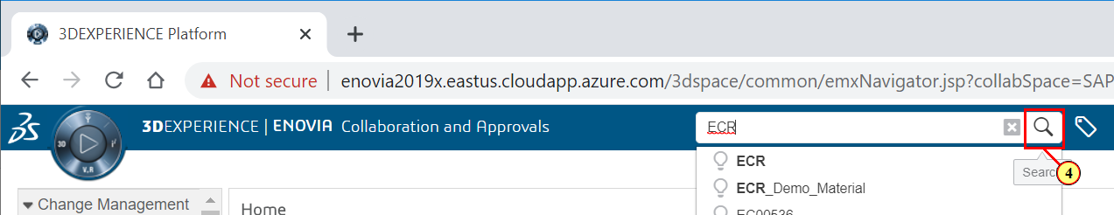
3DEXPERIENCE Platform - Google Chrome
(4) Click the Magnifying Glass to Search.

Slide 6
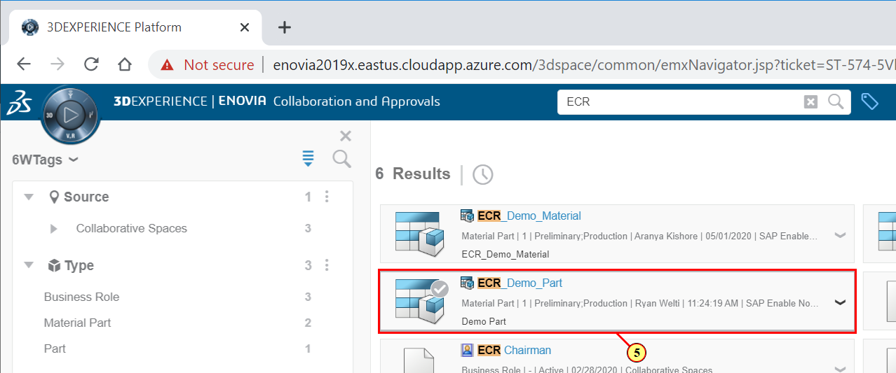
3DEXPERIENCE Platform - Google Chrome
(5) Select your Material Part from the search Menu.

Slide 7
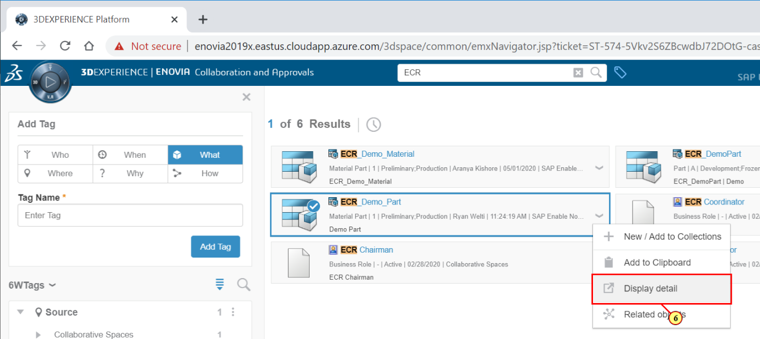
3DEXPERIENCE Platform - Google Chrome
(6) Click Display Detail to view details of the part.

Slide 8
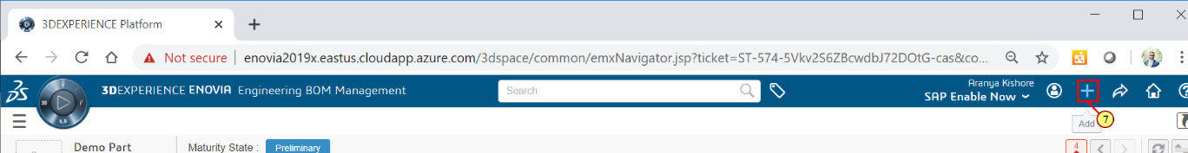
3DEXPERIENCE Platform - Google Chrome
(7) Click the Addition Button to start a new task.

Slide 9
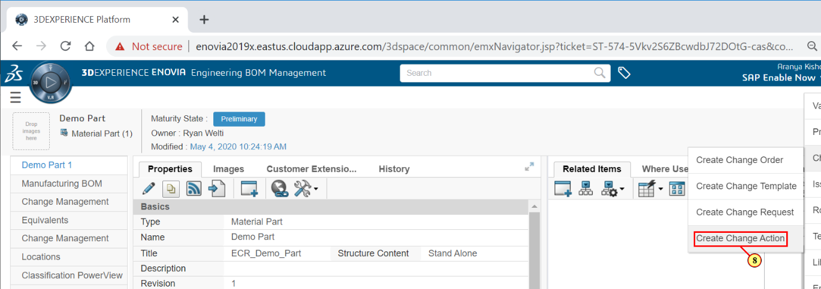
3DEXPERIENCE Platform - Google Chrome
(8) Click Create Change Action.

Slide 10
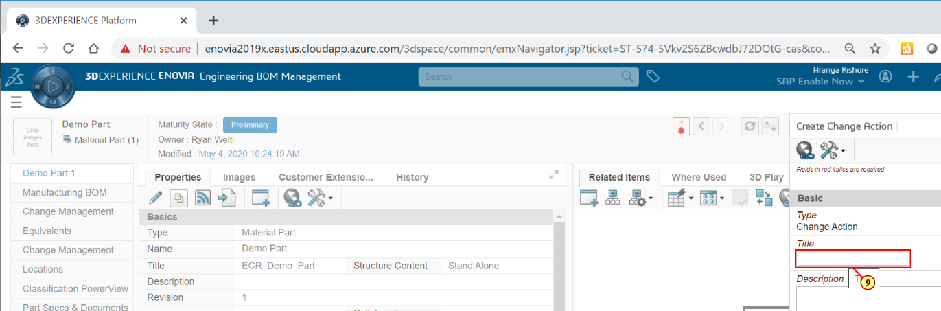
3DEXPERIENCE Platform - Google Chrome
(9) Enter a Title for your Change Action.

Slide 11
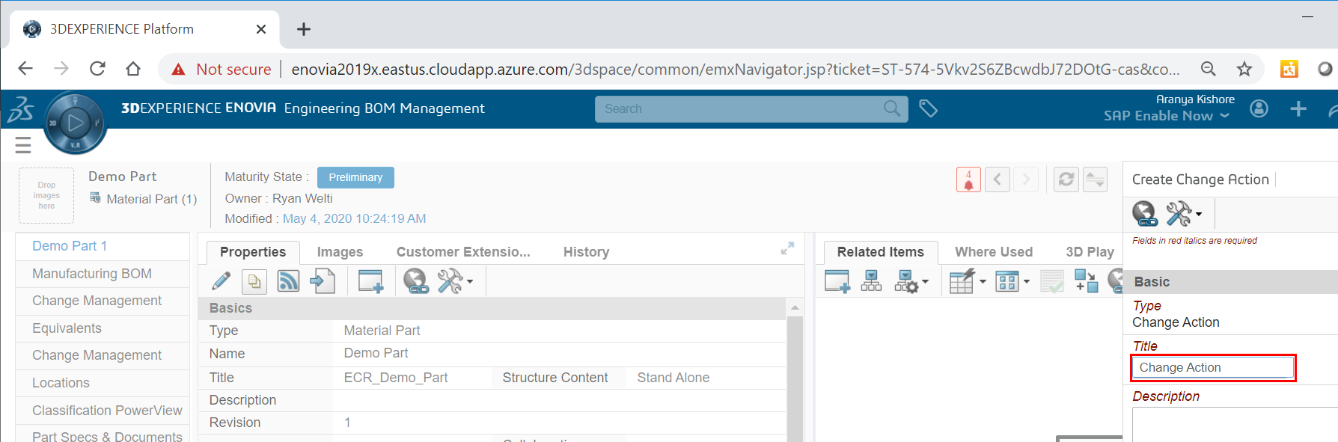
3DEXPERIENCE Platform - Google Chrome

Slide 12
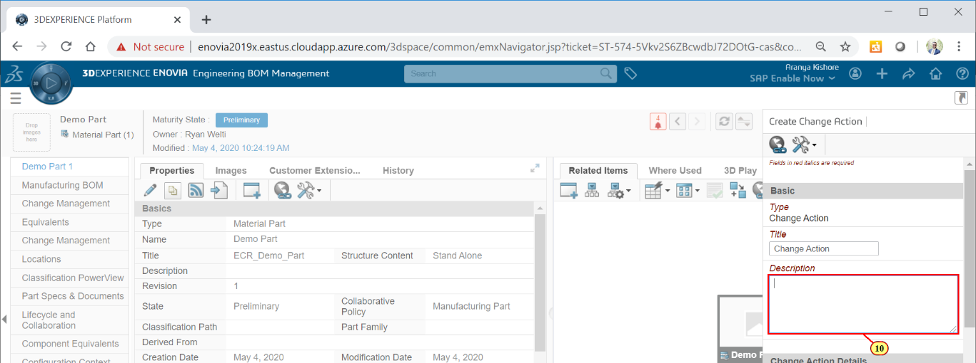
3DEXPERIENCE Platform - Google Chrome
(10) Enter a Description.

Slide 13
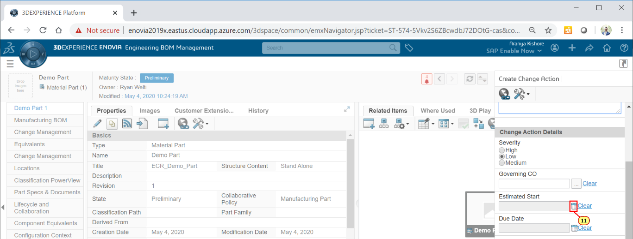
3DEXPERIENCE Platform - Google Chrome
(11) Click the Calendar Icon to enter an Estimated Start.

Slide 14

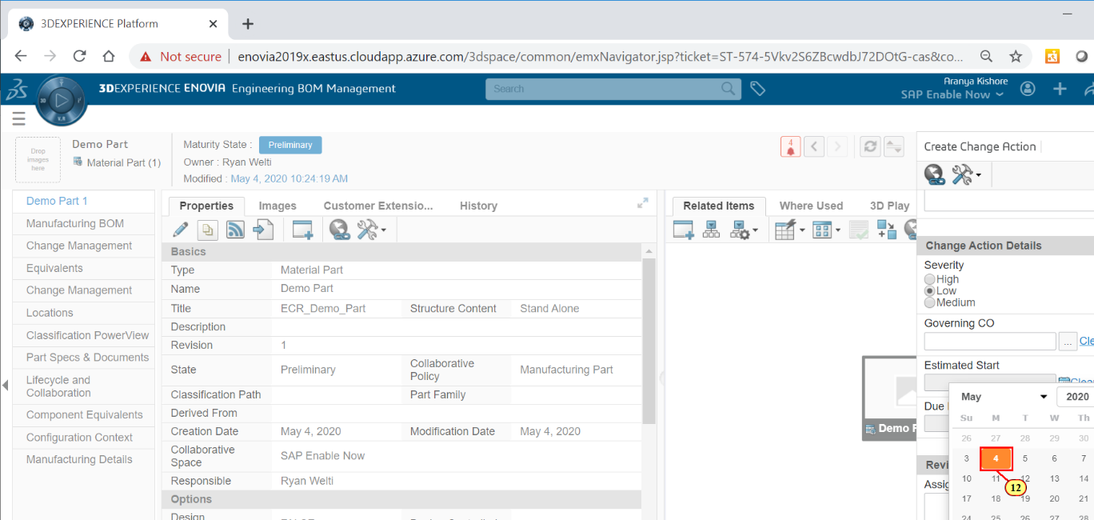
3DEXPERIENCE Platform - Google Chrome
(12) Click
.

Slide 15
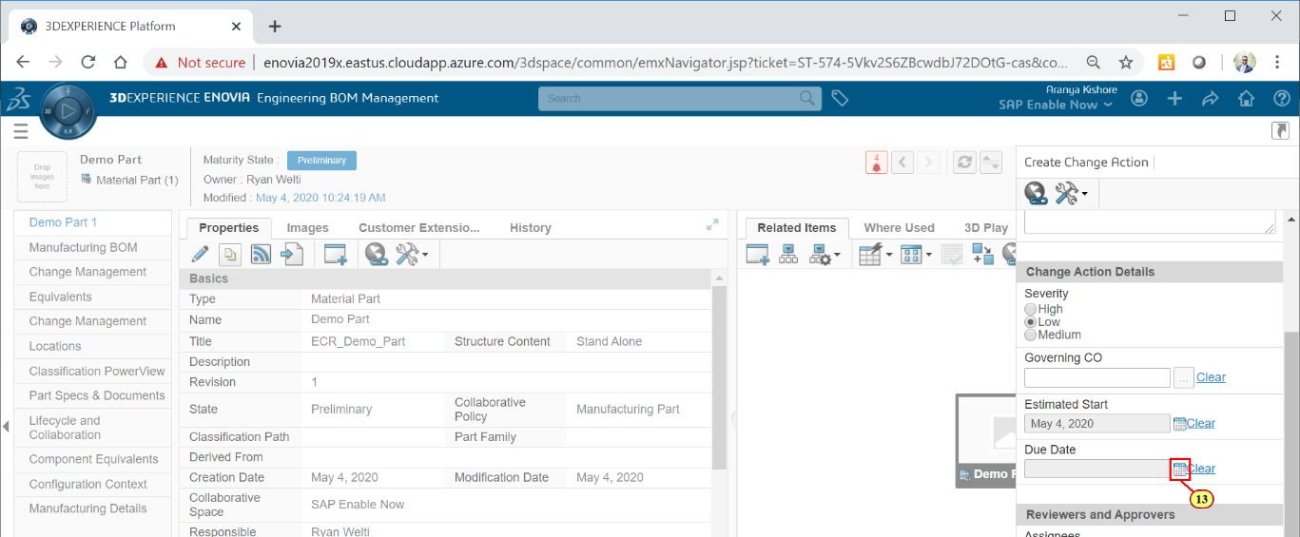
3DEXPERIENCE Platform - Google Chrome
(13) Click the Calendar Icon to enter a Due Date.

Slide 16

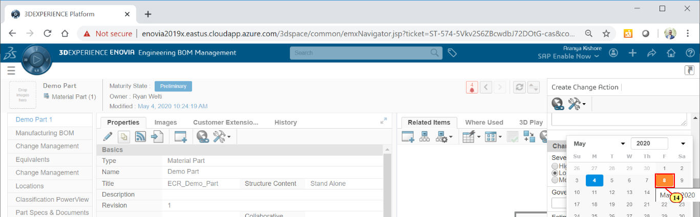
3DEXPERIENCE Platform - Google Chrome
(14) Click
.

Slide 17
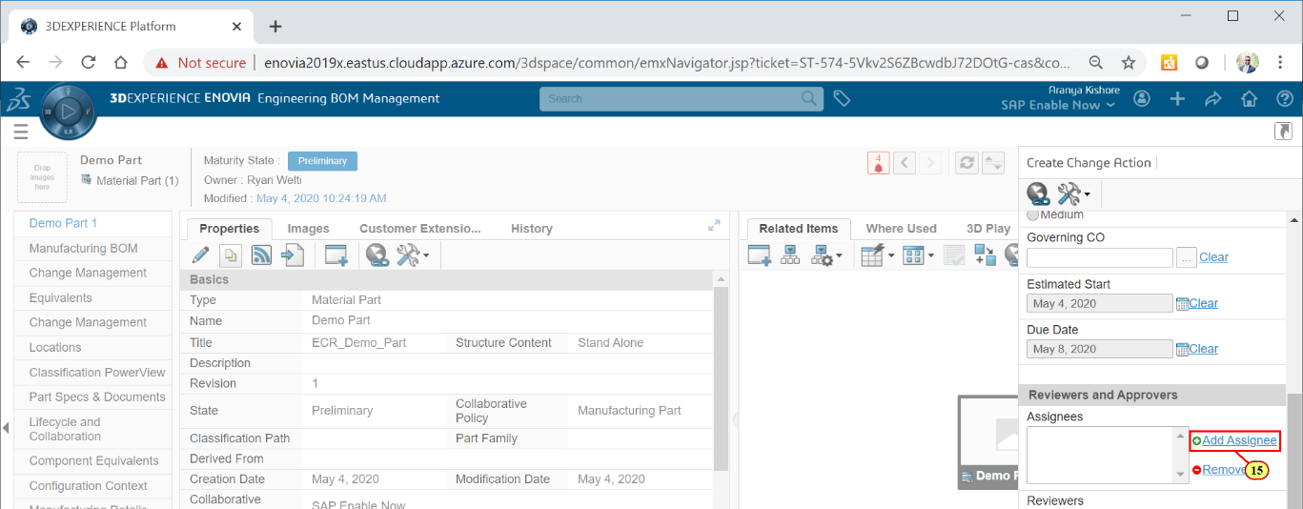
3DEXPERIENCE Platform - Google Chrome
(15) Click Add Assignee.

Slide 18
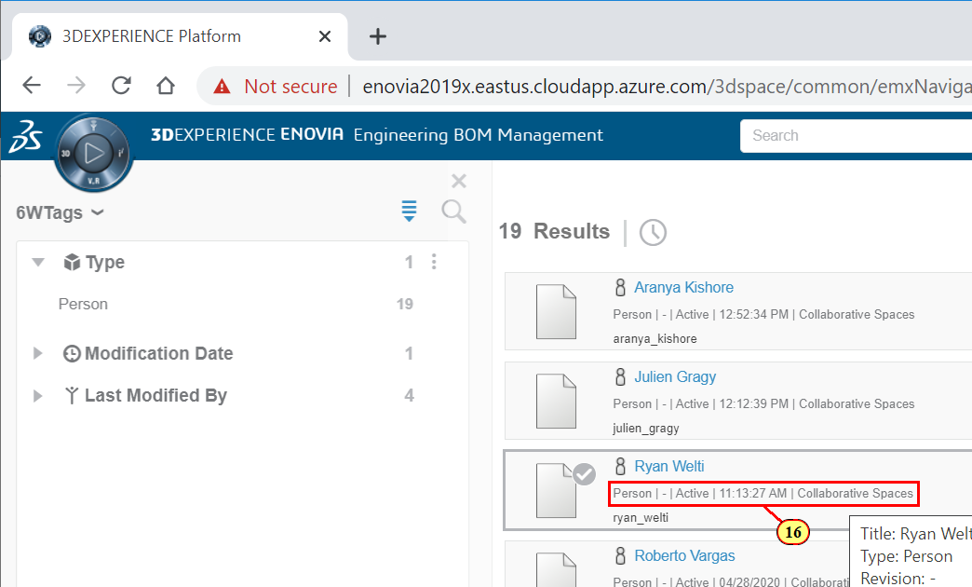
3DEXPERIENCE Platform - Google Chrome
(16) Select a n Assignee from your list.

Slide 19
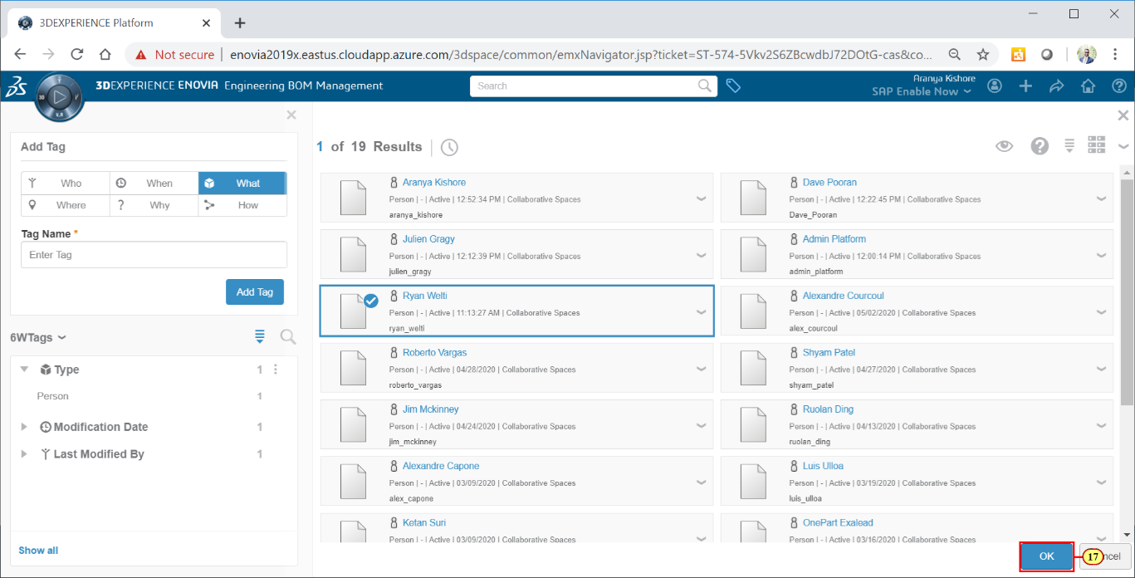
3DEXPERIENCE Platform - Google Chrome
(17) Click OK.

Slide 20
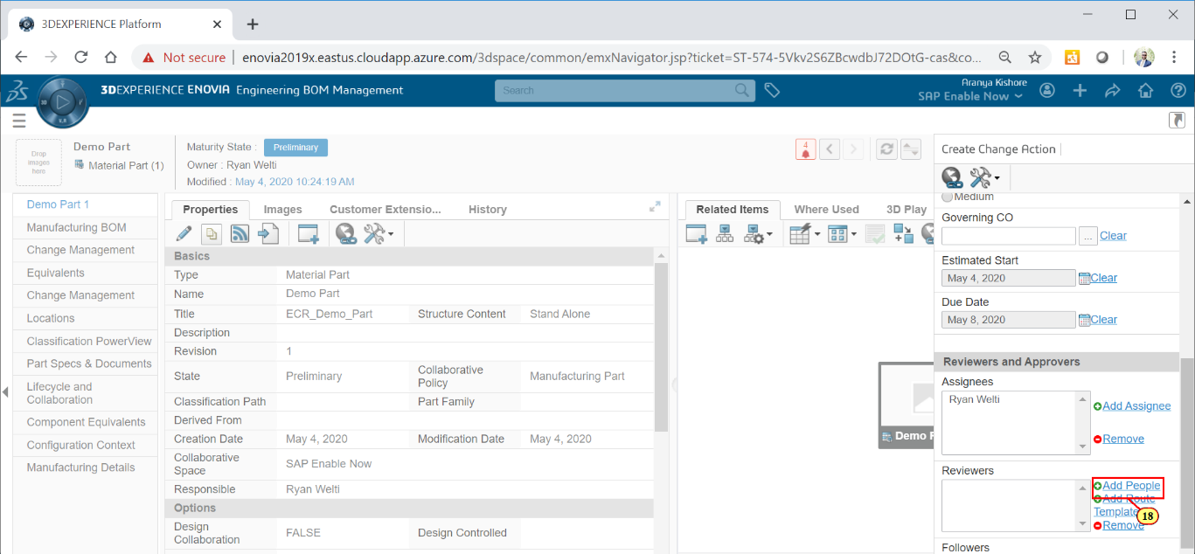
3DEXPERIENCE Platform - Google Chrome
(18) Click Add People to add a Reviewer.

Slide 21
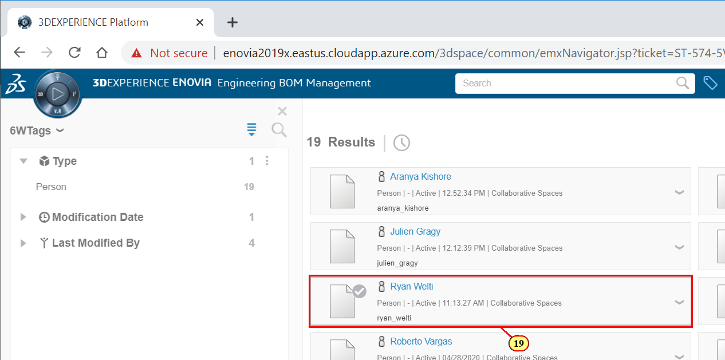
3DEXPERIENCE Platform - Google Chrome
(19) Select your Reviewer from the list.

Slide 22

3DEXPERIENCE Platform - Google Chrome
(20) Click Ok.

Slide 23
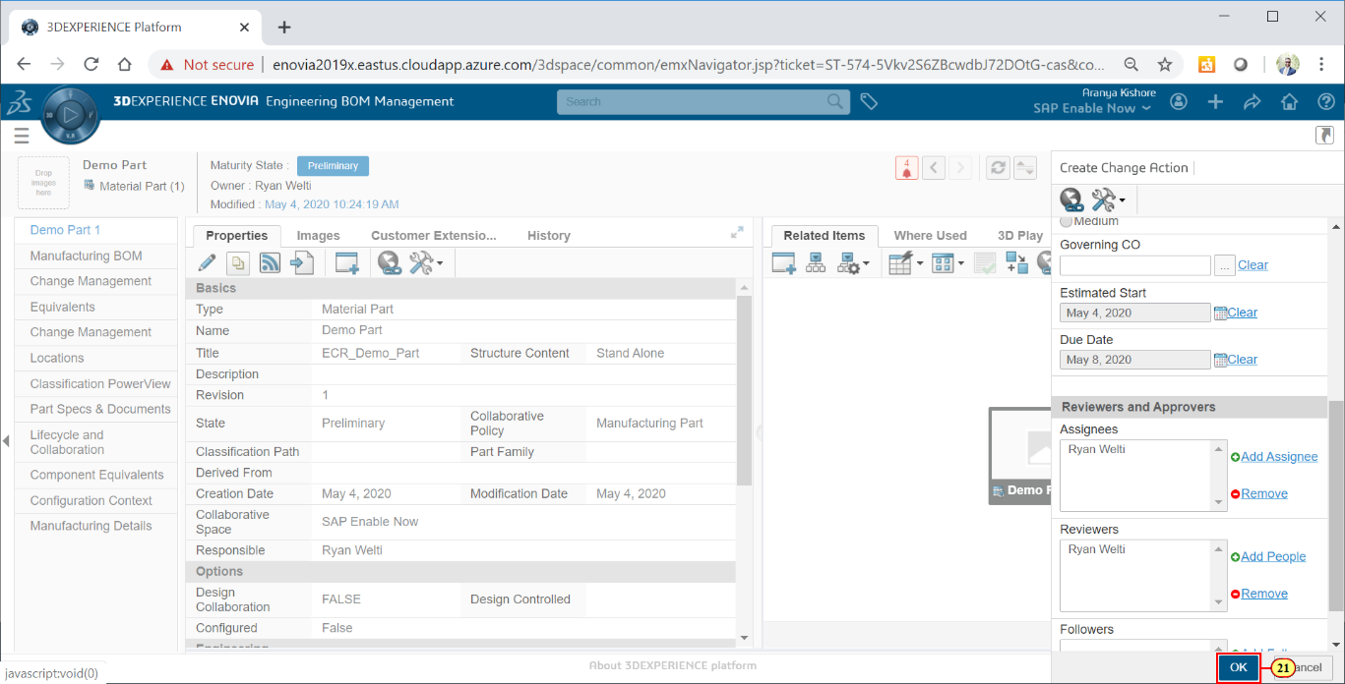
3DEXPERIENCE Platform - Google Chrome
(21) Click OK when finished.

Slide 24
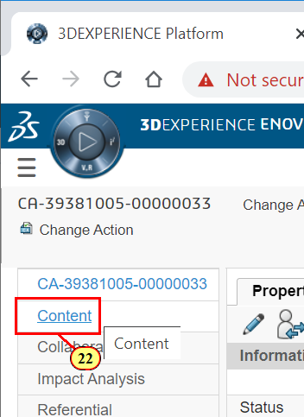
3DEXPERIENCE Platform - Google Chrome
(22) Click Content

Slide 25
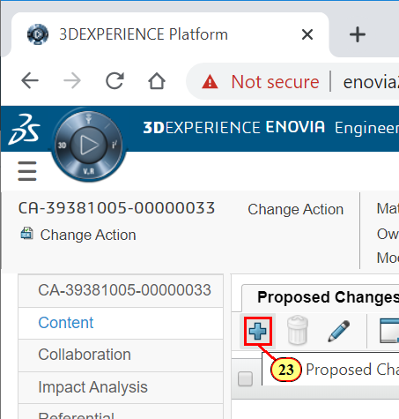
3DEXPERIENCE Platform - Google Chrome
(23) Click Plus to Add Proposed Change.

Slide 26
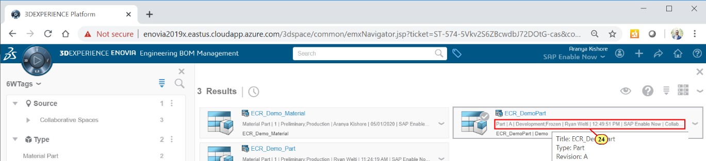
3DEXPERIENCE Platform - Google Chrome
(24) Select the part you are changing.

Slide 27
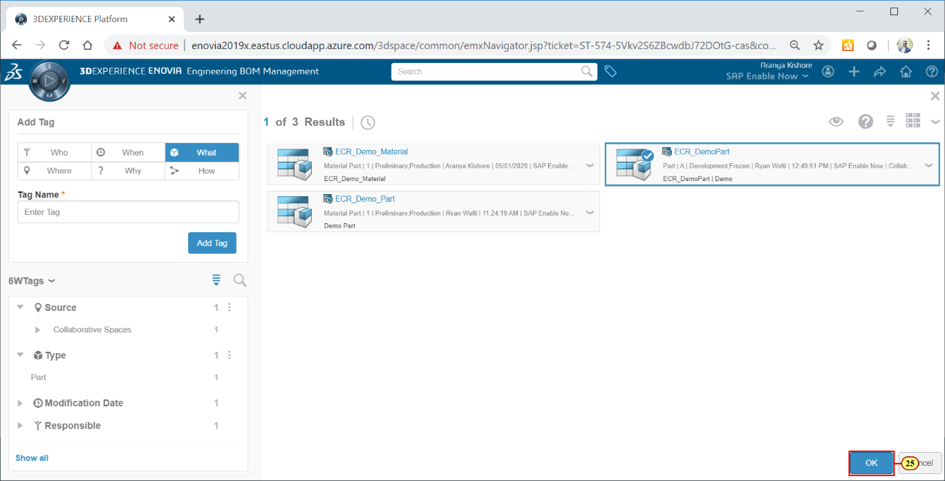
3DEXPERIENCE Platform - Google Chrome
(25) Click OK when finished.

Slide 28
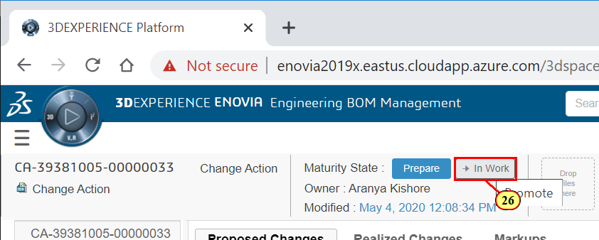
3DEXPERIENCE Platform - Google Chrome
(26) Click to Promote the Change Order.

Slide 29
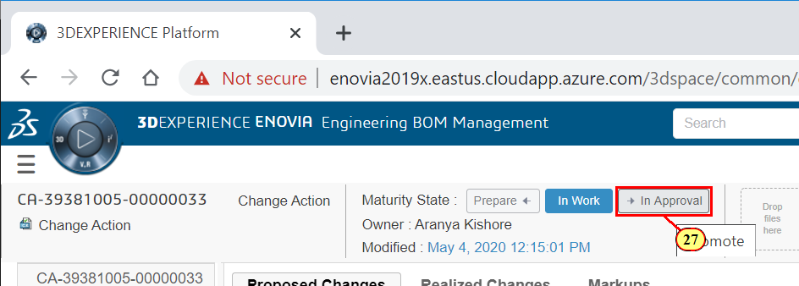
3DEXPERIENCE Platform - Google Chrome
(27) Click
.

Slide 30

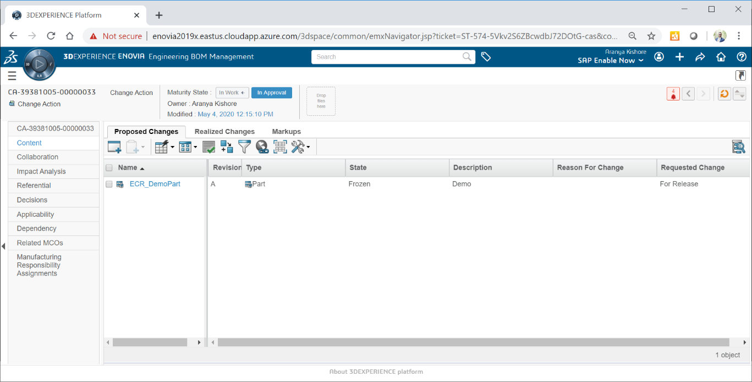
3DEXPERIENCE Platform - Google Chrome
Change Order has been sent to the Approver.
Click to exit the demo.

